Slide 1
Cyberminer: Web Search
Engine
Alaa Jalali, Yong hyun Lee, Andres Mancillas, Matthew McCoy, Fionne Tran, Parsa Zilaee

Slide 2
Table of contents
01
Project Overview
03
Design
02
Requirements
04
Prototype
The description of the project
Use Case, Sequence, and Class Diagrams
Specify user and system requirements
Overview of prototype implementation

Slide 3
01
Project Overview
The description of the project

Slide 4
Project Overview
Develop a simple web search engine, Cyberminer
Use Object-Oriented Analysis and Design principles
Our team utilized Astah to create UML diagrams
Build a prototype using an Object-Oriented Program
Our team used Python to implement our prototype
Accessible through team’s web page (GitHub) and/or own device (e.g. PC, laptop)

Slide 5
02
Requirements
Specify user and system requirements

Slide 6
Functional Requirements
The Cyberminer System shall:
Accept a list of keywords and return matching URLs
Support case-sensitive search and preserve input format
Enable hyperlink enforcement for easy website navigation
Allow specifying OR/AND/NOT search modes
Run multiple search engines concurrently
Delete outdated URLs and their descriptions
List query results in ascending alphabetical order or other specified criteria
Provide options to set the number of results per page and navigate between pages
Implement autofill and typographical error correction
Filter out non-meaningful symbols based on user configuration

Slide 7
Functional Requirements (cont.)
Stakeholders and Different Features: Organizational users, individual users, advertisers, and Cyberminer administrators are some of the stakeholders in this project. The specific needs and requirements of each stakeholder group are taken into consideration. Different features or functionalities should be provided to cater to distinct requirements given by stakeholders. For example, organizational users might require advanced search options or analytics features, while individual users may prioritize ease of use and personalized settings.
Input and Output Handling: The input of Cyberminer should come from a user interface, whether it's a website or a command line, where keywords can be entered by the user. The input is processed and displays a list of URLs that can be seen by the user in the format of a website or a downloadable file.
Non-Meaningful Symbol Filtering: Users should be able to choose which symbols or characters that can be filtered out from the search keywords, and this can be done using a configuration option. This feature ensures that irrelevant symbols do not affect the search results.

Slide 8
Non-Functional Requirements
The Cyberminer System shall:
Cyberminer should be easily understandable, portable, enhanceable, and reusable
Ensure good performance for efficient search operations
Design the system to be user-friendly, responsive, and adaptable
Maintain the KWIC system's usability and readability

Slide 9
Non-Functional Requirements (cont.)
Understandable and User-Friendly: Clear and intuitive user interfaces, error messages, and documentation. The system should provide appropriate feedback and guidance to users during their interactions.
Portable and Reusable: Compatible with multiple platforms and operating systems. This allows for easy deployment and integration with different environments. It is also important to use modular and well-documented code to promote reusability and maintainability.
Enhanceable and Adaptable: Designed for for easy enhancements and modifications in the future. This can include using modular architecture, well-defined APIs, and proper documentation to facilitate future development and integration of new features.
Good Performance: Specific performance targets such as response time for queries, throughput (number of queries processed per unit of time), and scalability (ability to handle increased workload or data volume) can be provided to show the performance of Cyberminer.
Responsive: The system’s responsiveness in terms of user interface interactions. Provide prompt and smooth responses to user actions, such as submitting a search query, navigating between pages, or adjusting settings.

Slide 10
03
Design
Architectural Design Specification: Use Case, Sequence, and Class Diagrams

Slide 11
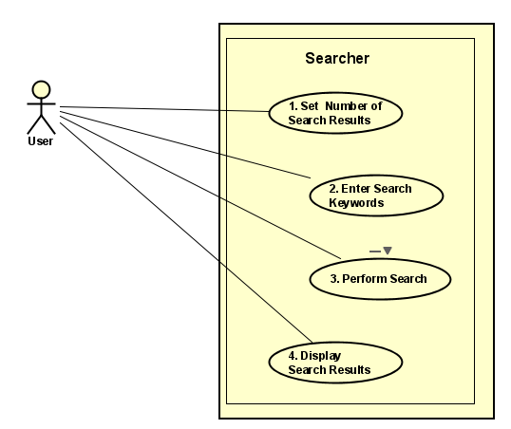
Use Case Diagram
Use Case
Sequence
Class

Slide 12
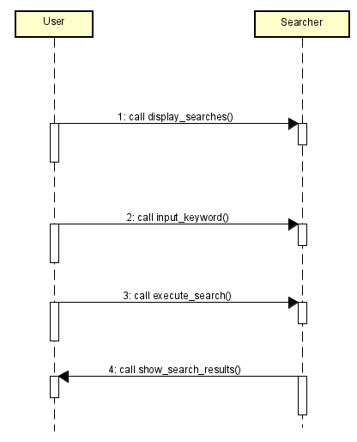
Sequence Diagram
Use Case
Sequence
Class

Slide 13
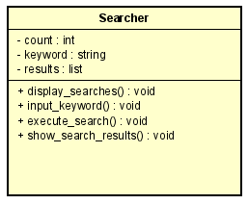
Class Diagram
Use Case
Sequence
Class

Slide 14
04
Prototype
Overview of prototype implementation

Slide 15

Prototype Implementation
Overview
How our current prototype implementation works:
: Enables utilizing Google to search.
Our current prototype can:
Accept User Input (Number of results, and Keyword)
Perform Search
Display Search Results
Completed
Next Steps

Slide 16
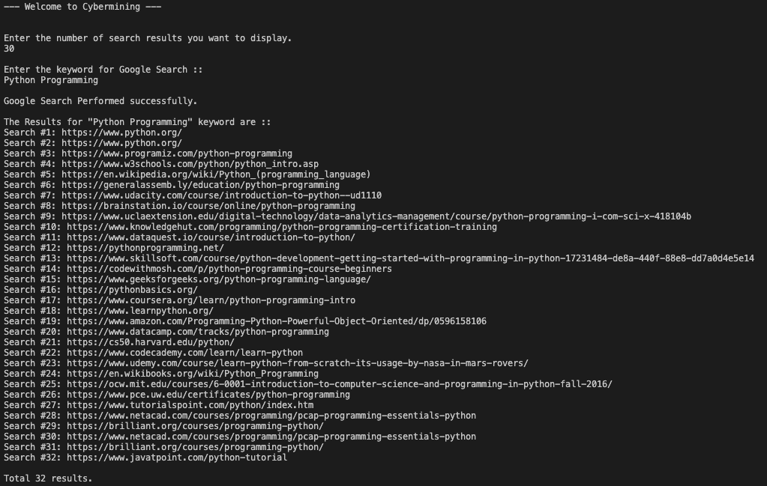
Overview
Completed
Next Steps

Slide 17
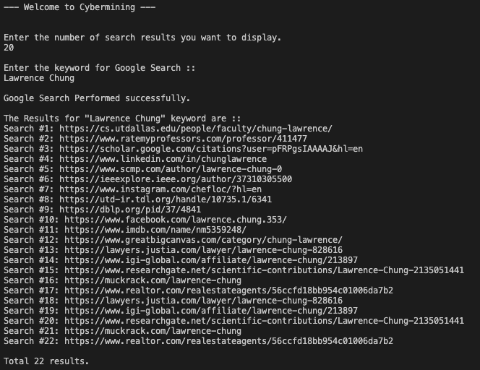

Slide 18
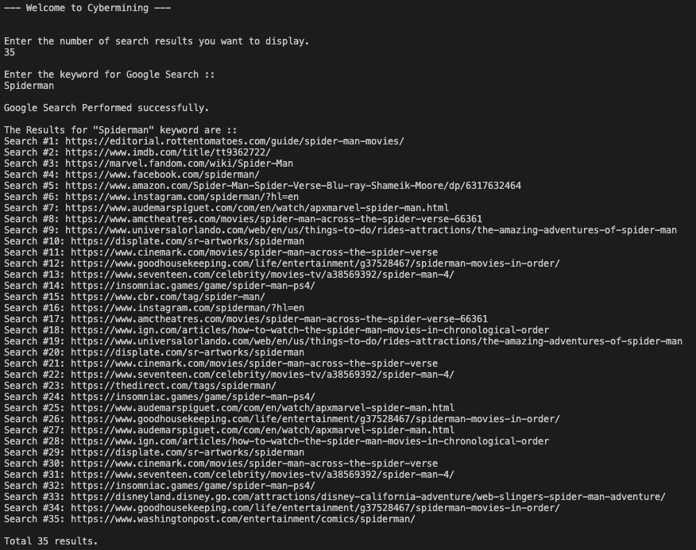

Slide 19

Limitations
Overview
> Mismatching the requested number of results (32 instead of 30)
> Duplicate results (#1 and #2)
Completed
Completed
Next Steps
Next Steps

Slide 20
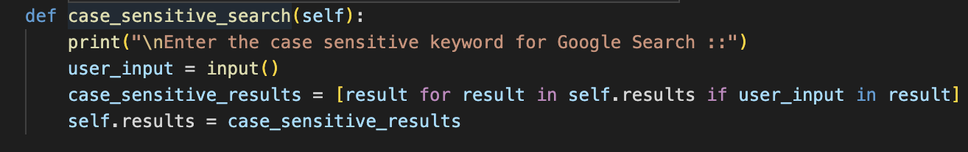
What is Next?
Overview
Completed
Case Sensitive Search Implementation
To improve our prototype our next central focus will be :
Implement case-sensitive search
Specify the search mode (OR/AND/NOT)
Implement multiple search engines concurrently
Select function out of each iteration to see meta-information of the selected number of URLs
Next Steps

Slide 21
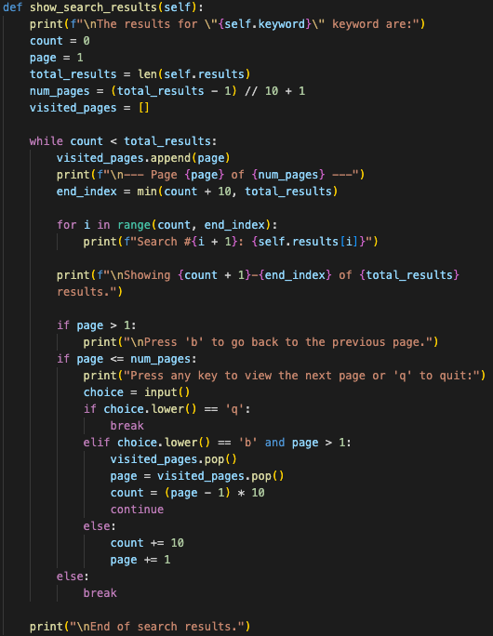

What is Next?
Overview
Navigate between pages
Setting the number of results per page = 10.
User decide whether going back or forth of the page.
Displays current pages with total pages.
Easy to add further implementation.
Completed
Next Steps

Slide 22
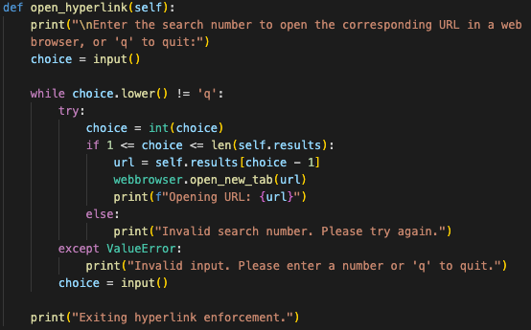
What is Next?
Overview
Hyperlink Enforcement
Import webbroswer
Select indice to open URL.
Opening URL by default system web browser.
Completed
Next Steps

Slide 23
Thank You!

